Slide 1
UCB - CS189 Introduction to Machine Learning Fall 2015 Lecture 9: Performance evaluation
Isabelle Guyon
ChaLearn

Slide 2
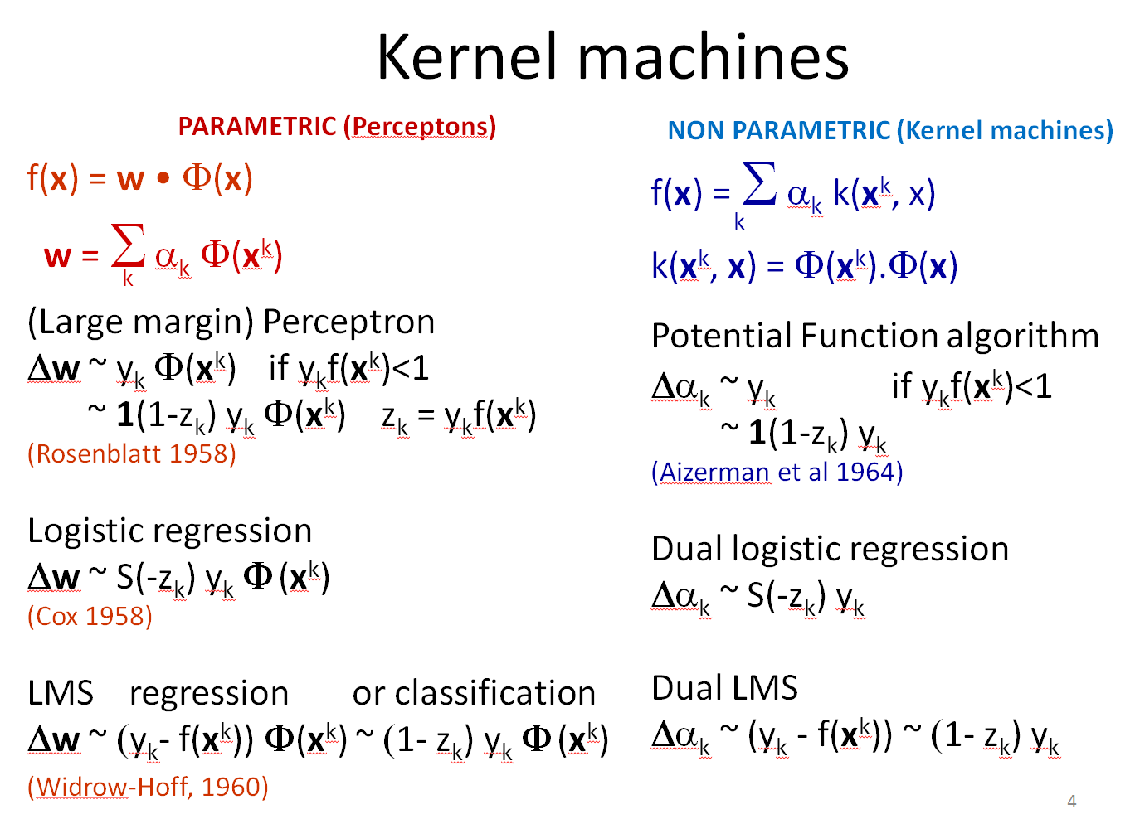
Come to my office hours… Wed 2:30-4:30 Soda 329
Last time

Slide 3

Come to my office hours… Wed 2:30-4:30 Soda 329
Today
Next time

Slide 4
Math prerequisites
Bernouilli distribution
Binomial law
Statistical tests

Slide 5

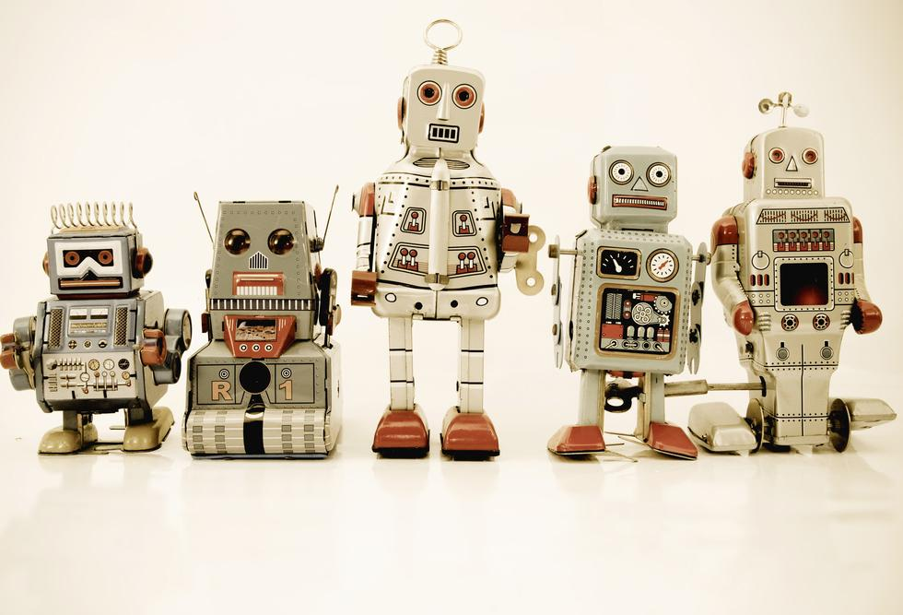
Changing roles
YOU
YOUR STAFF

Slide 6
You have formulated your problem as a “machine Learning” problem
d
X={x^{k}_{i}}
y ={y^{k}}
x^{k}
N
α
w

Slide 7
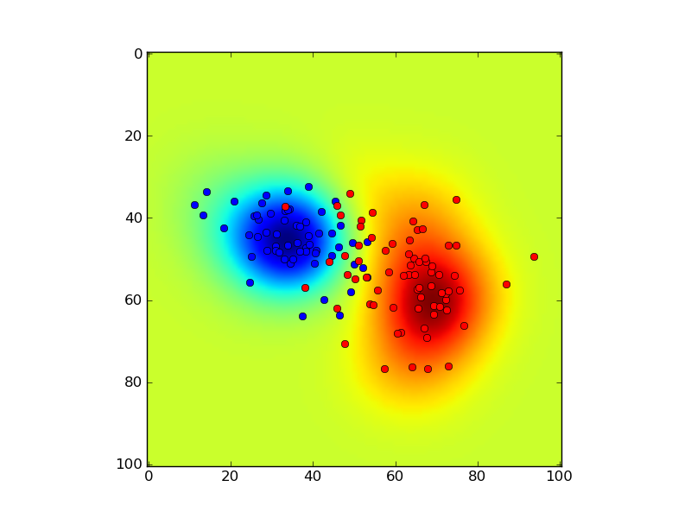
Main question:
How well do models generalize on new test data?
The true generalization error is the expected risk R[f] = ∫ L(f(x, w), y) dP(x, y)
But you do not know P(x, y), you can only get n TEST examples (x₁, y₁), (x₂, y₂), … (x_{n}, y_{n}), distinct from the N training examples.
R_{test}[f] = (1/n) Σ_{k=1:n} L( f(x^{k}), y^{k} )

Slide 8

Give them good data!
Are your data I.I.D.?
Split your data into training and test set.
Do NOT release the target values y for the test data.
Beware of data leakage through:
Sample IDs
Sample order
Confounding factors

Slide 9

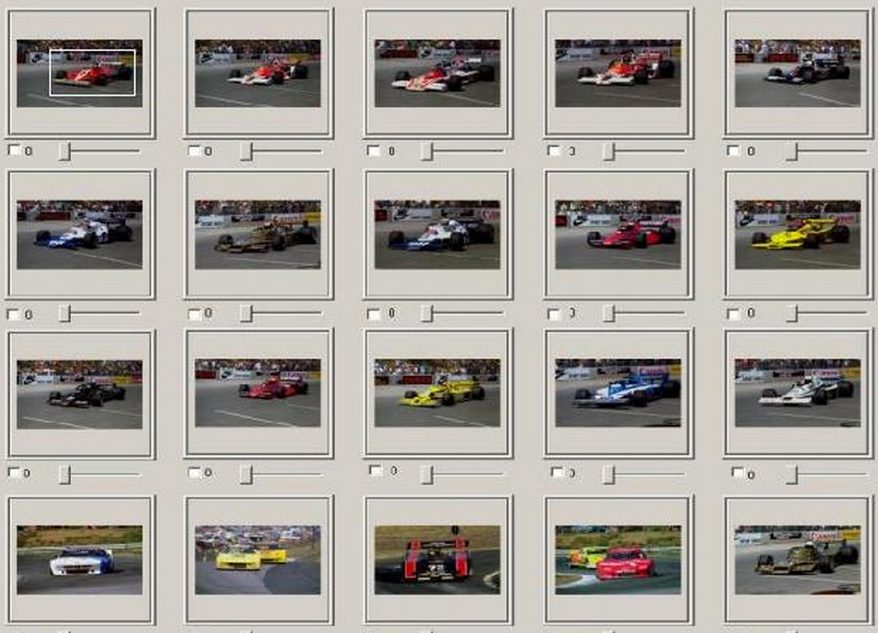
Example of confounding

Slide 10
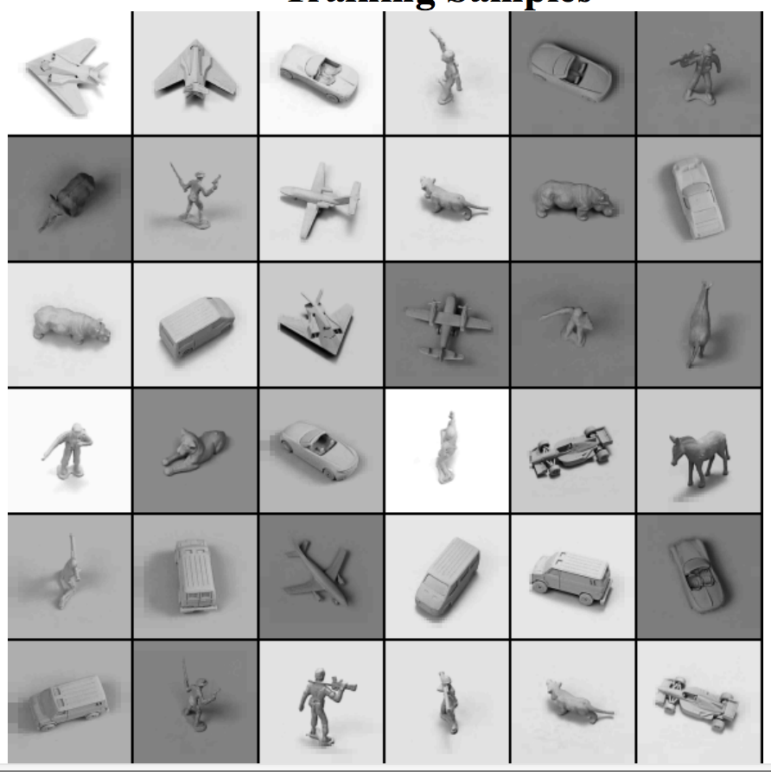
Have a good study design
Control.
Block.
Randomize.
http://www.cs.nyu.edu/~ylclab/data/norb-v1.0/

Slide 11
Your “staff” has taken CS 189/289
They know about linear and kernel methods:
f(x) = w • Φ(x) = Σ_{k} α_{k} k(x^{k}, x)
They know how to “train” them:
f*(x) = argmin_{f} R_{train}[f] + λΩ[f] λ>0
with R_{train}[f] = (1/N) Σ_{k=1:N} L( f(x^{k}), y^{k} )
for a choice of loss functions L
(hinge loss, logistic loss, square loss)
and a choice of regularizers Ω (such that ǁwǁ²)

Slide 12
Ask them to produce 3 models: 1) “Hebb’s rule” linear model f(x) = w • x = Σ_{k} y_{k} x^{k} • x 2) Regularized linear model f(x) = w • x = Σ_{k} α_{k} x^{k} • x 3) Non-linear model f(x) = w • Φ(x) = Σ_{k} α_{k} k(x^{k}, x)
d
y ={y^{k}}
X={x^{k}_{i}}
x^{k}
N
α
w

Slide 13
Can they always train 3 models?
Market
Analysis
10⁶
Ecology
Computer
Vision
OCR
HWR
10⁵
Text
Categorization
10⁴
N training examples
10³
System diagnosis
10²
Bioinformatics
10
d inputs
10
10²
10³
10⁴
10⁵
10⁶

Slide 14
Statistical domains
Market
Analysis
10⁶
Ecology
Computer
Vision
OCR
HWR
10⁵
Non linear kernel methods
Text
Categorization
10⁴
N training examples
10³
Linear model with Hebb’s rule
Regularized linear models
with hinge/logistic/least-square
System diagnosis
10²
Bioinformatics
10
d inputs
10
10²
10³
10⁴
10⁵
10⁶

Slide 15
Computational domains If you have to invert a matrix, either N or d must be small
Linear model with Hebb’s rule
Non-kernelized
linear models with matrix inversion
or QP solvers
(inversion of a (d, d) matrix)
Non-kernelized
linear models with gradient descent
(no matrix inversion)
Kernel methods,
including kernelized linear models
with gradient descent
(no matrix inversion)
Market
Analysis
10⁶
Ecology
Computer
Vision
OCR
HWR
10⁵
Text
Categorization
10⁴
N training examples
Kernel methods,
including kernelized linear models
with matrix inversion or QP methods
(inversion of a (N, N) matrix)
10³
System diagnosis
10²
Bioinformatics
10
d inputs
10
10²
10³
10⁴
10⁵
10⁶

Slide 16
Memory usage domains Key: do we need to store the (N, N) matrix K or (d, d) matrix X^{T}X?
Linear model with Hebb’s rule
Non-kernelized
linear models with matrix inversion
or QP solvers
(need (d, d) matrix X^{T}X)
Non-kernelized
linear models with gradient descent
Kernel methods,
including kernelized linear models
with gradient descent
Market
Analysis
10⁶
Ecology
Computer
Vision
OCR
HWR
10⁵
Text
Categorization
10⁴
N training examples
Kernel methods,
including kernelized linear models
with matrix inversion or QP methods.
Need (N, N) matrix K.
10³
System diagnosis
10²
Bioinformatics
10
d inputs
10
10²
10³
10⁴
10⁵
10⁶

Slide 17

Other questions:
Should the loss function L be the same for training and testing?
How do I compute error bars?
How many test examples are needed to get “significant” results?
Can the test set be used to compare several models?
Should I continue the project or not?
Should I hire better data scientists or collect more data?

Slide 18
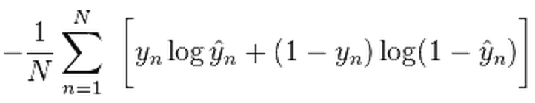
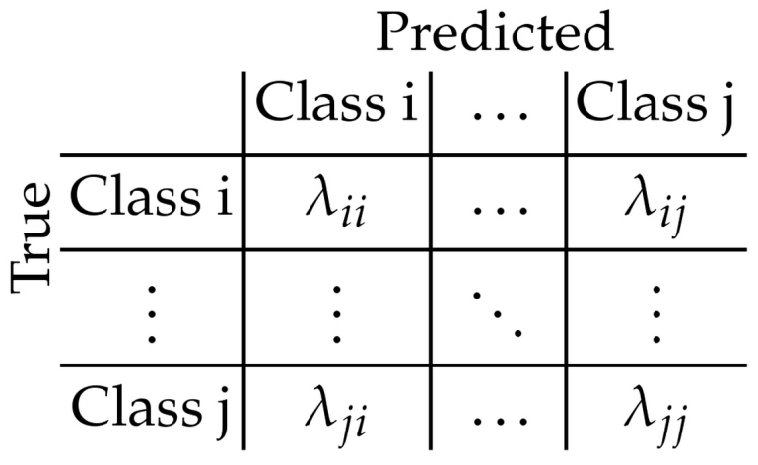
Cost functions to compute a “score”
Error rate E (or accuracy A = 1-E).
Balanced Error Rate BER (or balanced accuracy BAC=1-BER).
Cross-entropy H= ).
A loss based on a cost matrix:
Area under ROC curve.
Mean square error or the R² = 1-MSE/VAR.

Slide 19
Original decision boundary
f(x) < 0
f(x) < 0
x₂
x₂
f(x) = 0
f(x) = 0
f(x) > 0
f(x) > 0
x₁
x₁
Notes:
Which one is best : linear or non-linear
The decision comes when we see new data
Very often the simplest model is better
This principle is implemented in Learning Theory

Slide 20
Overlay test examples,
count FP and FN
f(x) < 0
f(x) < 0
x₂
x₂
f(x) = 0
f(x) = 0
f(x) > 0
f(x) > 0
x₁
x₁
Notes:
Which one is best : linear or non-linear
The decision comes when we see new data
Very often the simplest model is better
This principle is implemented in Learning Theory

Slide 21
Move up the decision boundary: fewer False Negative
f(x) < -1
f(x) < -1
x₂
x₂
f(x) = -1
f(x) = -1
f(x) > -1
f(x) > -1
x₁
x₁
Notes:
Which one is best : linear or non-linear
The decision comes when we see new data
Very often the simplest model is better
This principle is implemented in Learning Theory

Slide 22
Move down the decision boundary: fewer False Positive
f(x) < 1
f(x) < 1
x₂
x₂
f(x) = 1
f(x) = 1
f(x) > 1
f(x) > 1
x₁
x₁
Notes:
Which one is best : linear or non-linear
The decision comes when we see new data
Very often the simplest model is better
This principle is implemented in Learning Theory

Slide 23
ROC Curve
For a given threshold on f(x), you get a point on the ROC curve.
100%
Ideal ROC curve
Actual ROC
HITS
Positive class success rate
(hit rate, sensitivity)
Random ROC
0
100%
FALSE ALARMS
1 - negative class success rate (false alarm rate, 1-specificity)
Notes:
Explain that this is a global estimator

Slide 24
Area under ROC Curve
For a given threshold on f(x), you get a point on the ROC curve.
100%
Ideal ROC curve (AUC=1)
Actual ROC
HITS
Positive class success rate
(hit rate, sensitivity)
Random ROC (AUC=0.5)
0 ≤ AUC ≤ 1
0
100%
FALSE ALARMS
1 - negative class success rate (false alarm rate, 1-specificity)
Notes:
Explain that this is a global estimator

Slide 25
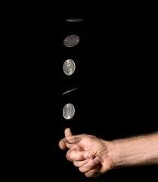
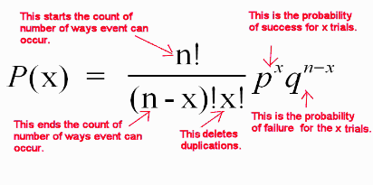
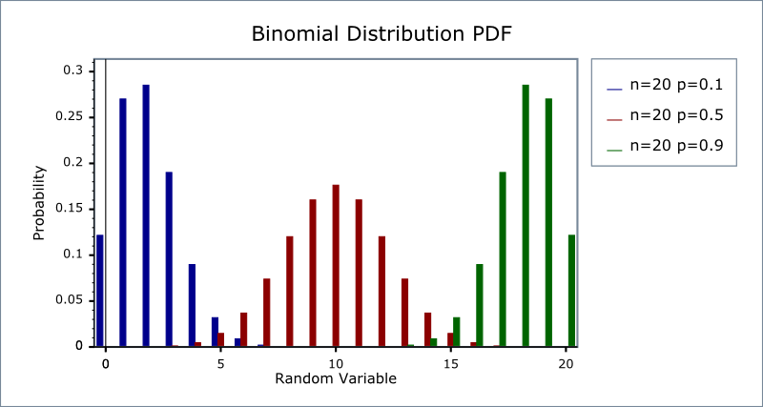
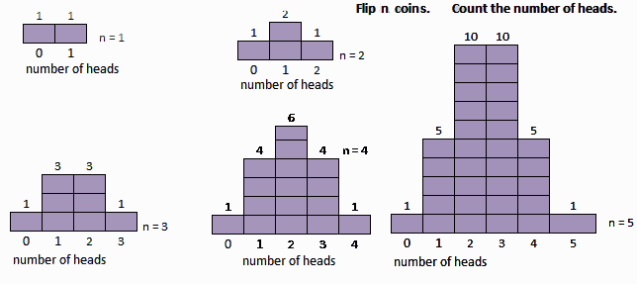
Error bars
Counting errors is like counting heads when tossing a biased coin.
Proba p of head and q=(1-p) of tail.
After n tosses, proba of x errors:

Slide 26
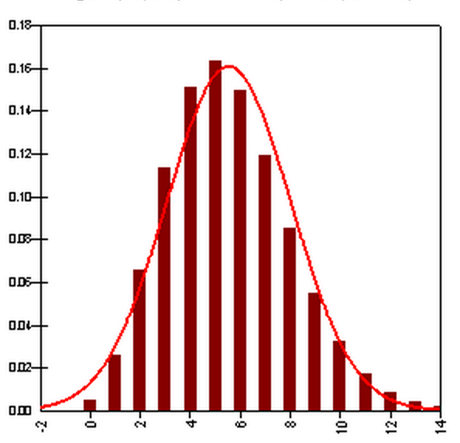
Error bars (continued)
Sqrt(np(1-p))
Density of getting x errors (heads) after
n=50 tosses with proba p = 0.1.
Follows the binomial distribution.
Expected value of x: np
Variance of x: np(1-p)
Expected value of the error rate E = x/n = p
Variance of x/n: σ² = var(x)/n² = p(1-p)/n
Use as error bar of the error rate E:
σ = √E(1-E)/n
n is the number of test examples.
np
More on error bars: http://www.ncbi.nlm.nih.gov/pmc/articles/PMC4175406/

Slide 27
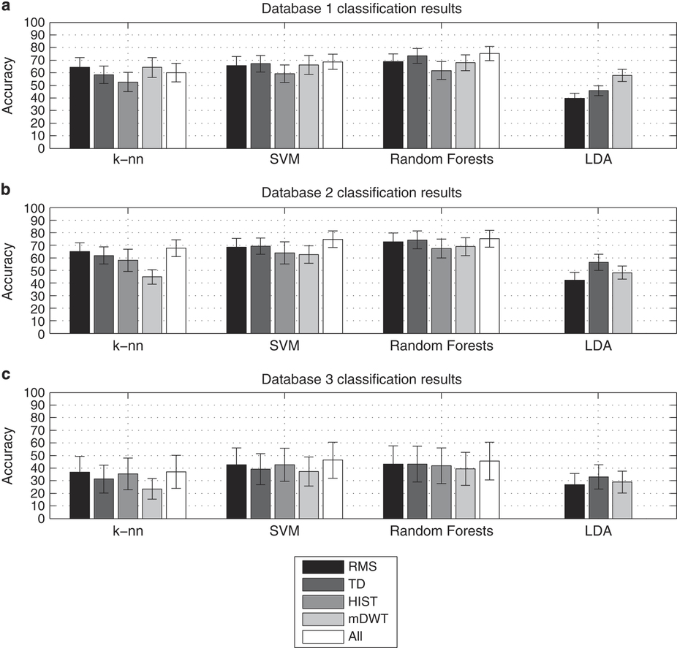
ML people like error bars…
http://www.nature.com/articles/sdata201453/figures/6

Slide 28
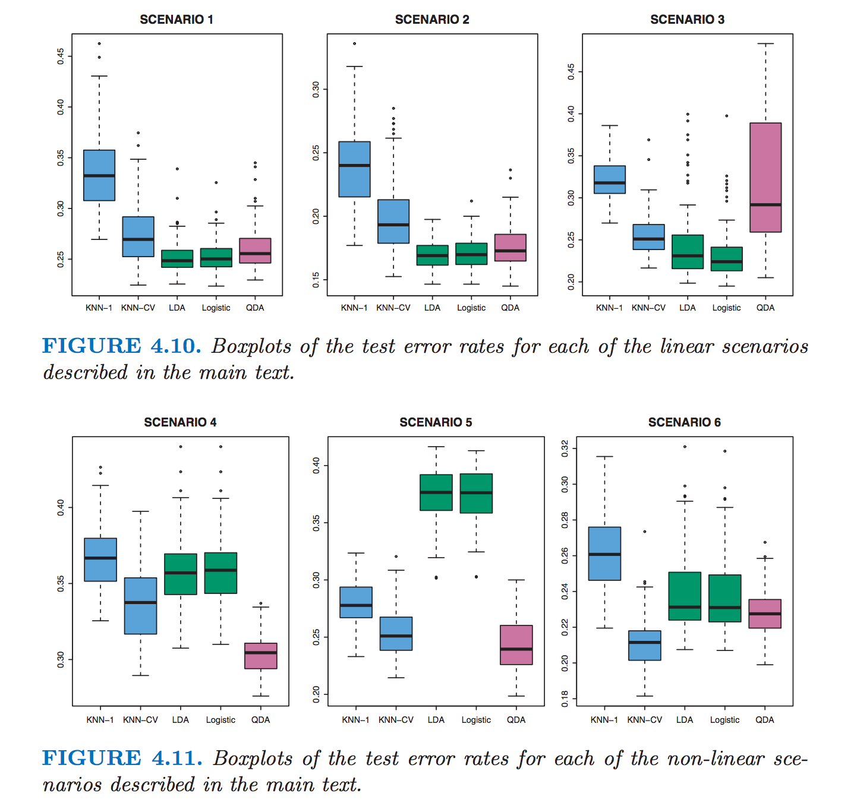
Statisticians like box plots…
http://www-bcf.usc.edu/~gareth/ISL/ISLR%20Fourth%20Printing.pdf, p. 152

Slide 29
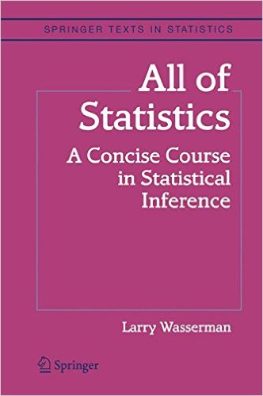
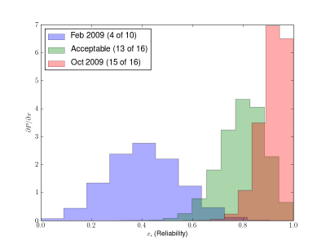
But where do we find the distributions of our favorite cost function???
OR use the bootstrap:
Read this book:
No math required!
You have n test samples; just resample (with replacements) subsets of n test samples many times (typically thousands) until the statistics you desire seem stable.
The average number of distinct observations in each sample is about 0.632n.

Slide 30
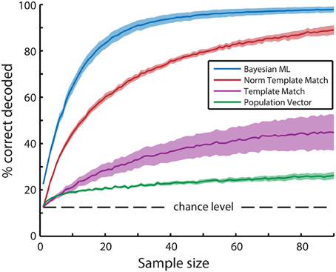
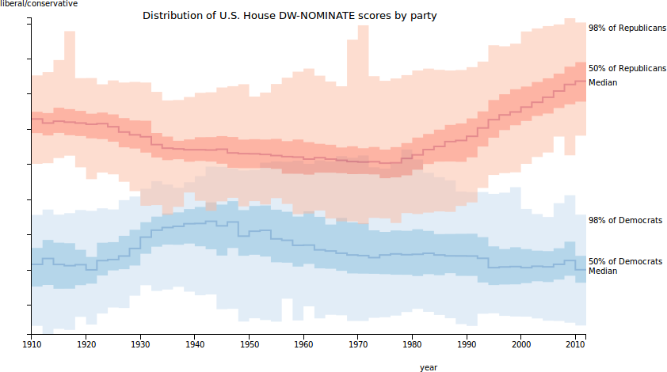
Bootstrap for error bars
http://journal.frontiersin.org/article/10.3389/fncom.2014.00058/full

Slide 31
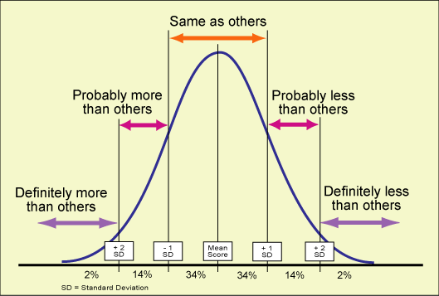
Result “significance”
http://brothersgrimmandgorey.blogspot.com/2010/03/using-statistical-significance-95.html

Slide 32
Hypothesis Testing
α
pval
Ingredients:
A “null hypothesis” H₀.
“H₀: my score is no different than the baseline”
A test statistic R (the score).
A distribution of R if H₀ is true (null distribution)
A risk value α and its corresponding threshold r_{α}, such that α=Proba(R > r_{α}).
A realization r₀ of R to be tested.
r_{α} r₀
r
If r₀> r_{α}, reject H₀, with risk α of being wrong.

Slide 33
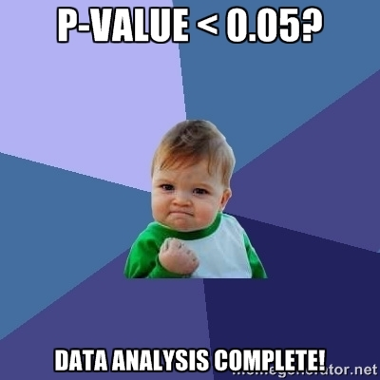
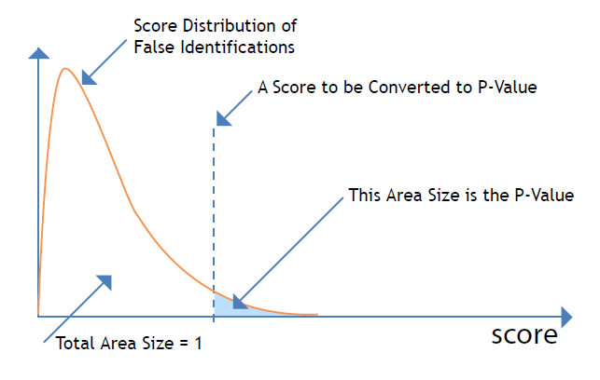
Pvalue
Your score distribution (obtained by bootstrap)
Reference score
Pvalue = fraction of score values above the reference score.
SMALL pvalues are good: they shed doubt on the “null hypothesis”.

Slide 34
Number of test examples needed
Variance of test error rate σ²= E(1-E)/n
For E<<1, σ² ≅ E/n (1)
Choose a given coefficient of variance σ/E=0.1, that is σ² = 0.01 E² (2)
Combining (1) and (2):
E/n = 0.01 E²
n = 100/E
Guyon et al., 1996. http://citeseerx.ist.psu.edu/viewdoc/summary?doi=10.1.1.33.3326

Slide 35
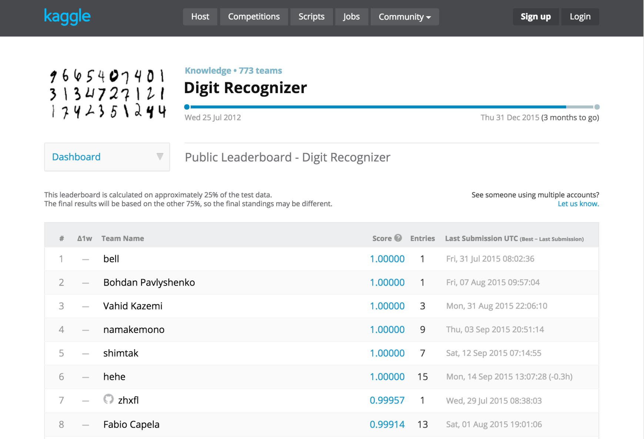
Can I use my test set to compare multiple methods?
~800 participants, ~3000 entries

Slide 36
Bonferroni correction
Pvalue = small proba of wrong conclusion.
Can I try m different ways of getting a small pvalue to increase my chances?
No! If m independent tests are performed, the fraction of correct decisions will be (1-pval)^{m}.
Bonferroni correction: Replace pval by m pval.
(or the risk α by α/m in a statistical test).

Slide 37
Paired test of significance
What difference in error rate between 2 classifiers is statistically significant?
McNemar paired test:
- assume classifier 1 is better
- ν_{i}=number of errors classifier i makes that the other classifier does not make.
- if E₂-E₁≥ (z_{α}/ν)sqrt(ν₁ +ν₂ ) reject H₀ of equality of error rates with risk α.
- one sided risk α=0.01, z_{α}=2.33.

Slide 38

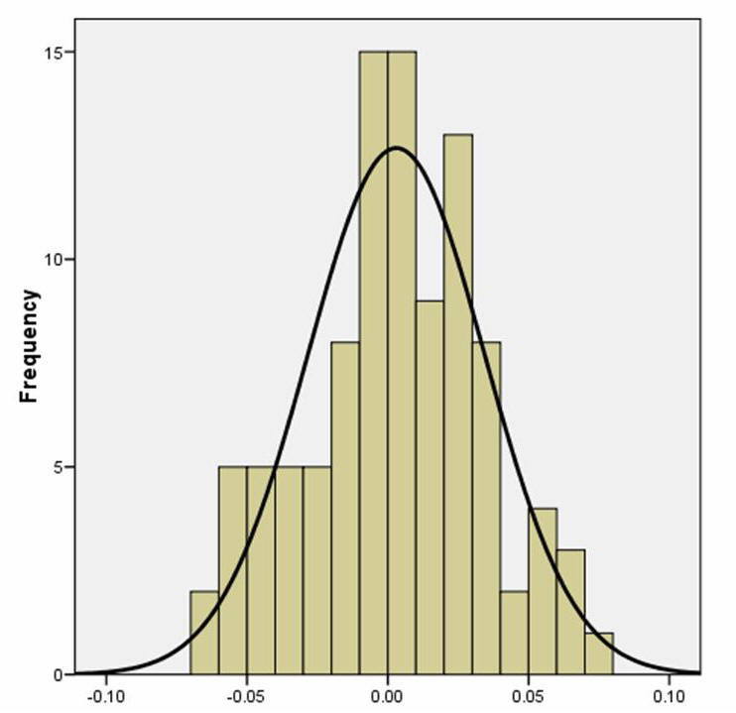
Should I continue the project?
You are here
You can also compare yourself to the chance distribution: permute at random many times the predicted values and re-compute the score.
0 0.5 1

Slide 39
Summary
Data is everything (more always better).
But: need “good data”. Avoid confounding and data leakage. Control, block, randomize.
Need to choose the right metric (AUC, pb. of imbalanced classes).
Compute error bars: σ²=E(1-E)n or bootstrap.
Case 1: Really crummy baseline results: Are they better than random? Permutation test.
Case 2: Really great results: Do we have enough errors to distinguish the baseline method from a better method? Increase test set size to n ~ 100/E.
Case 3: Middle perf: where the gain is potentially biggest. We want to try lots of methods. Understand pvalues and multiple testing. Bonferroni correction = pval * m.

Slide 40
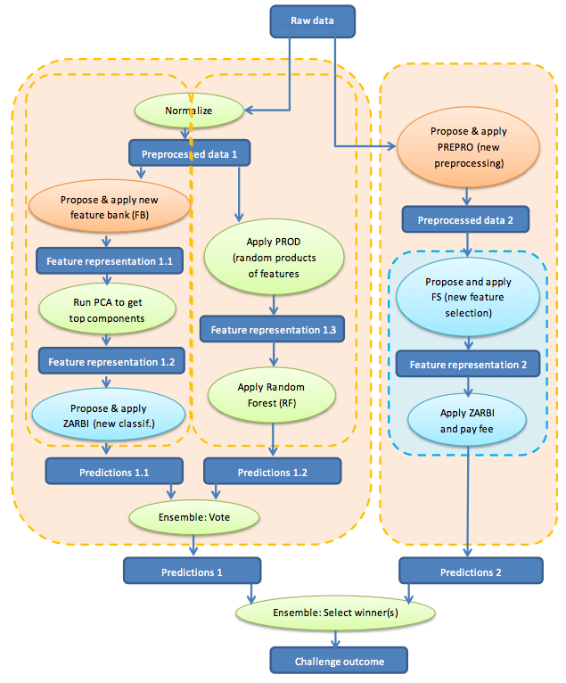
Come to my office hours… Wed 2:30-4:30 Soda 329
Next time: model search

